Slide 1
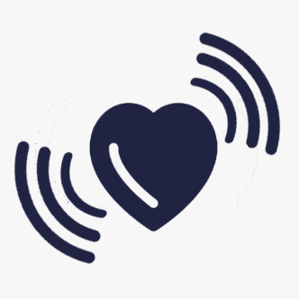
Final Presentation:
HealthBuzz
A health reminder
By Team 2:
Yang Hyeonseo
Song UGyeong
Jang Donghae
Jasmine Abtahi
Notes:
Suggests: decide on our main app color (both theme and text) and apply to ppt.

Slide 2
Quick recap on the project
Motivation
People who sit in front of their desk for long time need reminder to stretch (customized interval)
People who forget to drink enough water for health(8 cups)
Proposed Idea
By using sensor data, we build model to detect cup grabbing and inactive state and remind user automatically to drink water
Novelty
We provide different service by checking user’s smartwatch availability
We alarm user to drink water at appropriate time using ML.
We recommend YouTube videos based on the detected state (Stretch for sitting, Cool down, Running)

Slide 3
Demonstration
Login -> go to detail, and show stretching, water drinking motion
Notes:
Usage scenarios

Slide 4
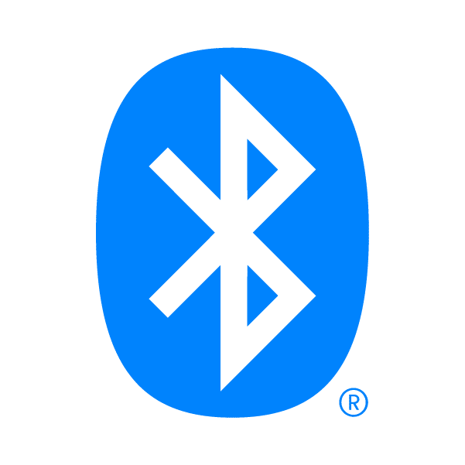

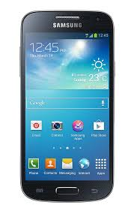
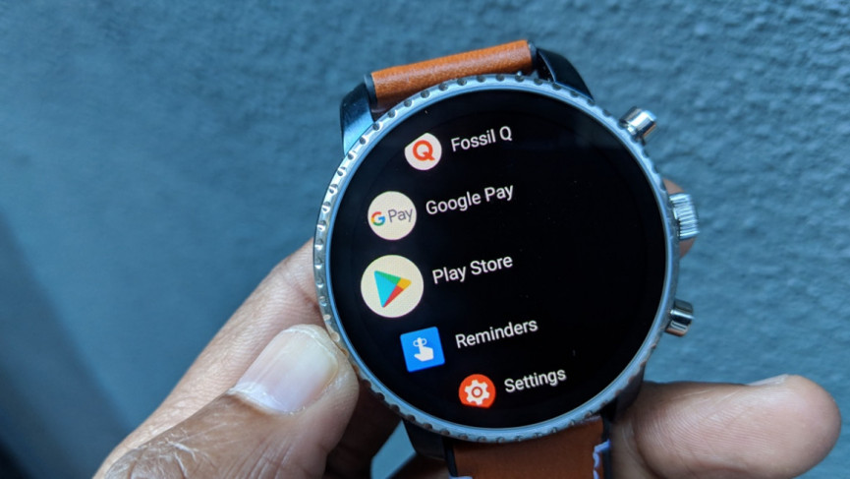


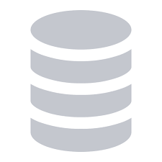
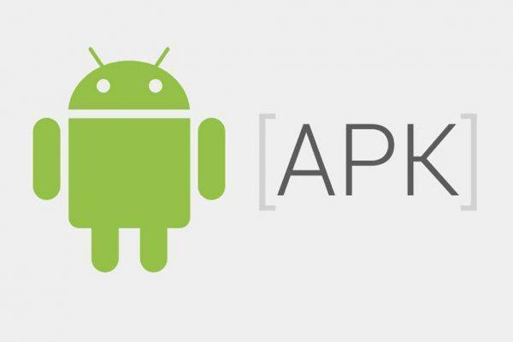

Health Buzz’s overall architecture
REST API
for phone
for smartwatch
REST API
Server deployed on Heroku

Slide 5
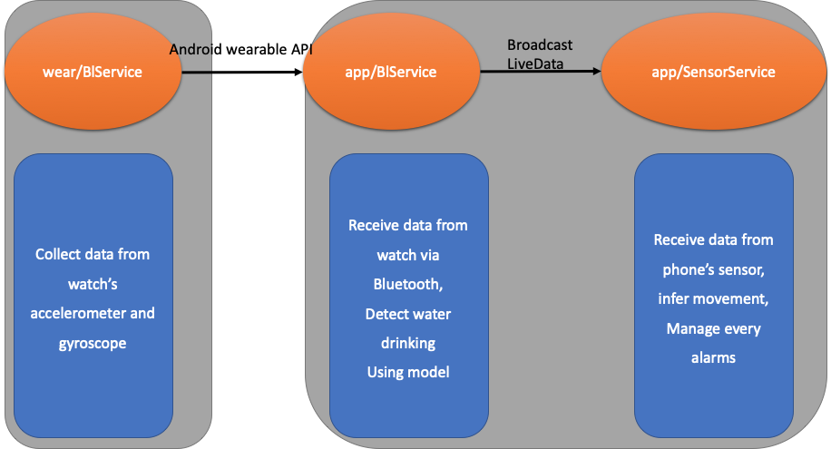
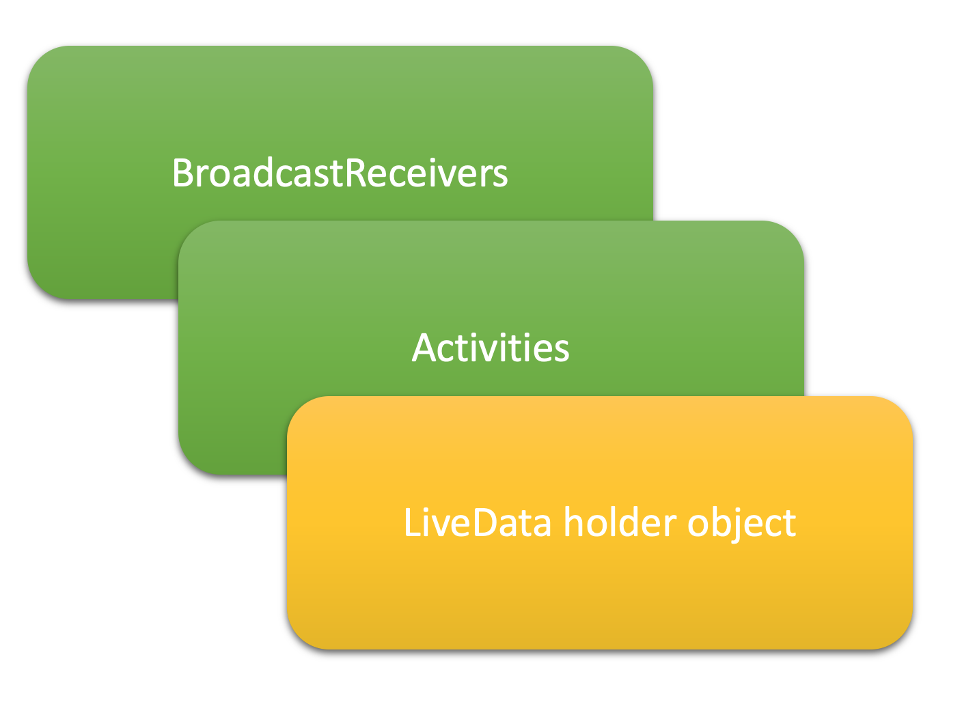
Health Buzz’s overall architecture

Slide 6
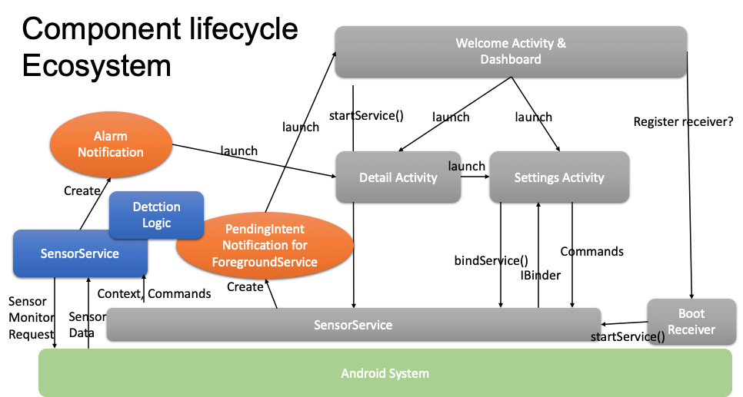
Deeper view of architecture

Slide 7
The system architecture overview
Two apps provided: one for android phone and the other for the android smartwatch.
There is a service for getting gyroscope and accelerometer data from smartwatch, and there are two services on android phone: one for listening for the phone’s sensor data and one for communicating with the watch.
Each services of the phone own their AI models, and they infer whether the user moved for a long time, or detect if the user drank water.
Every notifications are managed by SensorService.
Communications between all these components are by using Intent, Broadcast, and LiveData.
Notes:
얼마나 자세히 써야할지를 모르겠네요

Slide 8
Key technical challenges & solutions
The smartwatch and the phone should communicate with each other.
We use google wear api over bluetooth.
We have to infer whether the user is moving or sitting, and whether the user drank
Solved by using Weka library
We need to provide users’ rankings
We created backends
The app has to monitor the sensor even when the user is not using the app foreground.
Solved by creating a service
The service needs to be started automatically when the phone booting is finished.
Solved by registering a BroadcastReceiver
The UI needs to be updated in real time, based on settings and the service’s detection result.
Solved by adopting LiveData pattern
The app should communicate with user in background with low cost.
We use action-added notifications
Latency, Power, Accuracy
Latency: Fine enough
Power consumption: Low (two stage not needed for accelerometer)
Accuracy: 99% for moving motion.

Slide 9
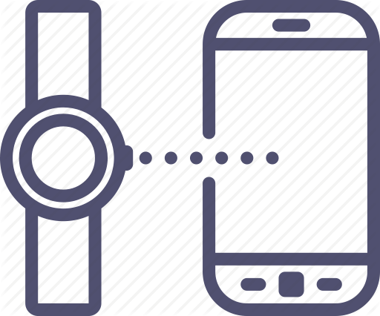
Solution approach 1 : Bluetooth
Connectivity issues: Such as any other wireless system, Bluetooth can’t be totally reliable. We had to make sure the connection stays continues. To solve this problem, we added parts of code that detects disconnectivity and resends the command to target to re-establish channels.
Delay: We faced delay issues when we asked the smart watch to send many sensor datas all at once. To fixed this issue, we added threads that run in the background to deliver the onSensorChanged messages to the host (mobile)
Detect the right target: Our app cannot connect just to any smart watch. It has to be a paired device that has our wear app installed. When we can’t detect a watch as described, we provide the option to add the count manually.

Slide 10



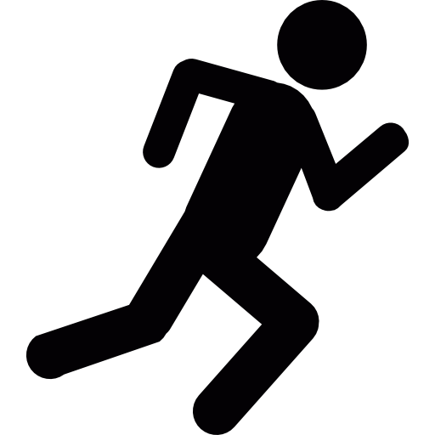
Solution approach 2 : ML, DL model for inference
Activity detection model
=> Check whether user doesn’t move for long time(ex. 60 min)
=> Notify user to stretch
Drink water detection model
=> Check user drinked or not
=> Give notification to add drink amount when user drank
=> Notify when user doesn’t drink water for long time

Slide 11
Solution approach 2 : data collection
Activity Detection data
Sensor | Accelerometer, Gyroscope
Label | Sitting, Walking, Running
Raw data dimension | 10000 * 6
Total time | 15 minute
Water drinking Detection data
Sensor | Accelerometer, Gyroscope, Heartrate
Label | Normal, up, drinking, down
Raw data dimension | 200000 * 6
Total time | 40 minute
Participant | 4 people(both right, left hand)

Slide 12
Solution approach 2 : Activity Detection model
Classifier candidate : NaiveBayes, DecisionStump, RandomForest
Find best model
Train/Test split : 7:3 split
Train the classifier candidates.
Check the test accuracy
RandomForest was best model
98% accuracy on test set
Also work fine for the realtime user test
Heursitic added
When user is classified as sitting, timer is counting time.
When user classified as walking or running more than 6 second, timer is reset
When timer counts all the left time, stretch notification is given to user

Slide 13
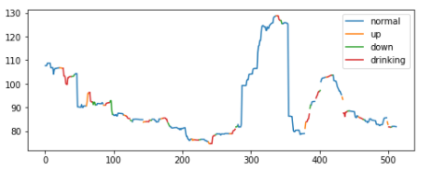
Solution approach 2 : Water drink data EDA
< Heartrate Graph>
Heartrate didn’t show any pattern for different labels
It is hard to use on realtime inference, because it is sampled in low frequency
It also didn’t give accuracy gain on our model

Slide 14
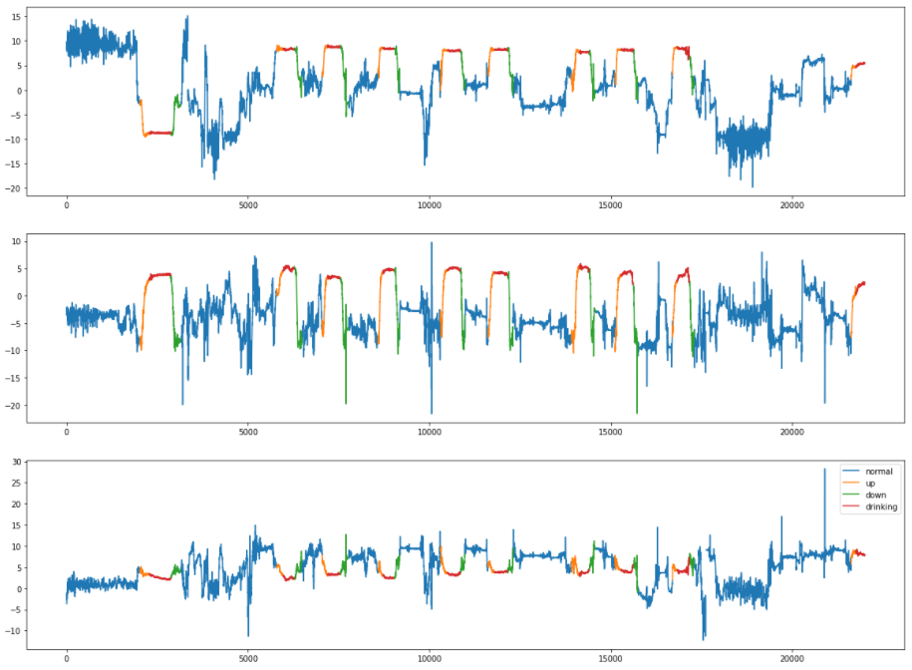
Solution approach 2 : Water drink data EDA
Accelerometer show clear pattern on different motion
It uses low battery, with high sampling rate
It also give lot’s of accuracy gain on our model
< Accelerometer Graph>

Slide 15
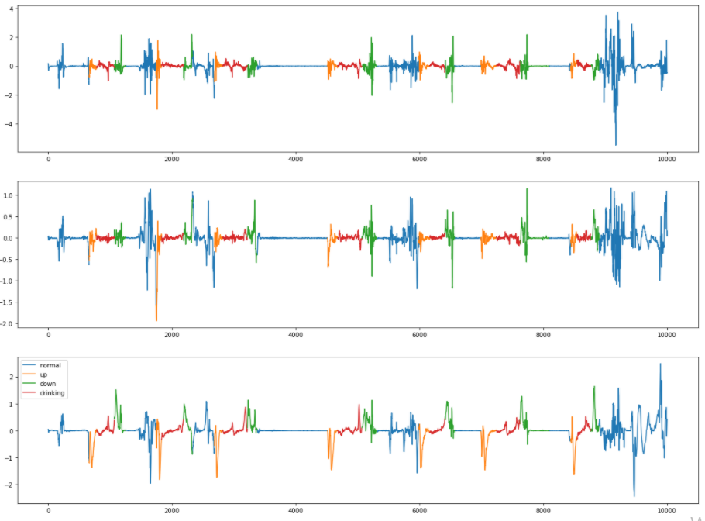
Solution approach 2 : Water drink data EDA
Gyroscope show some pattern but it is little bit ambiguous with normal pattern
It uses high battery, with high sampling rate
It also give small accuracy gain on our model
< Gyroscope Graph>

Slide 16
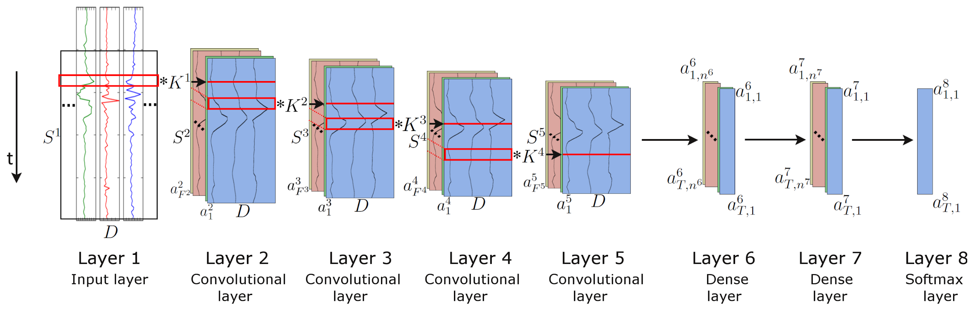
Solution approach 2 : Water drinking model
 | Model candidates | Accuracy / F1-score | note
ML | Randomforest | 88.2% / 82.0 | Feature extraction needed
DL | LSTM | 73.4% / 66.6
 | DeepConvLSTM | 76.5% / 68.3

Slide 17
Solution approach 2 : Water drinking model
Heuristic to use model to detect water drinking
Detect up => change state to up
Detect drink when we are on state up => state change to drink
Detect down when we are on state drink => state change to down
Detect normal when we are on state down => water drink detected!
State is maintained when that motion have more than 50% portion
By using Good Heuristic,

Slide 18
Evaluation Results2 : Inference
Model : RandomForest (with feature engineering)
Model Accuracy | Gyroscope + Accel : 88.2% / 82.0 Only Accel : 87.1 % / 81.1
Drinking detection Accuracy | Test set : 100% Real time test : about 90%
Latency | About 1 second (Bluetooth : 1 second?, Inference : almost 0)
Power | Approx 0.5% per Hour (Only accel)
Usability | It is little bit unstable on real time

Slide 19
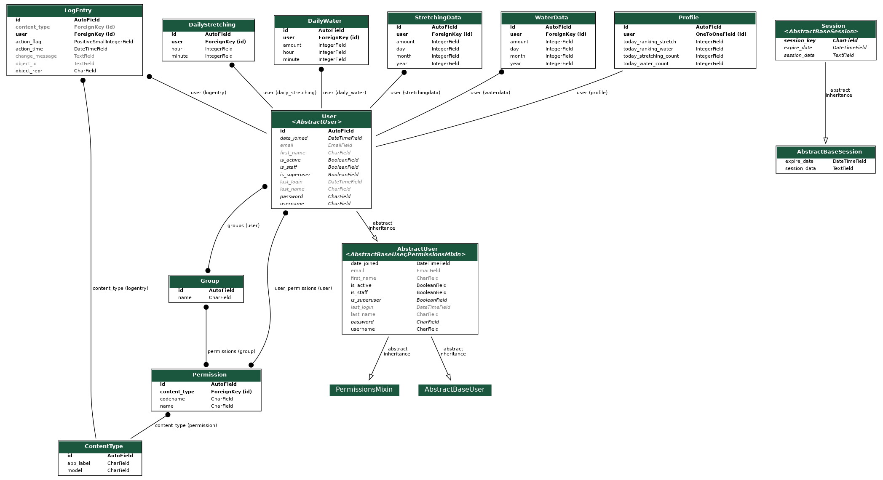
Solution approach 3 : Backend design
For Life Data
Today Data
(count, ranking ..)
User from Django
User can login, logout, and sign up
And they can get life data for detail and today data from deployed server
User can see other users and their daily ranking

Slide 20
Solution approach 4: Notification logic
Initial thought: Chain Observables from the sensor data to notification!
Low experience in reactiveX-tive way of thinking
Use traditional way like callbacks to run tasks based on timing

Slide 21
Final deliverable and success criteria
o Our Final APP
Using sensors of smart phone and watch, without setting fixed time people can get alarmed for their stretching and water drinking at their desired time interval.
To give some sort of accomplishment sense, they will get success batch when they do stretching and drinking.
People can also record and share their health history about stretching and water drinking.
o Our Success Criteria are
If our model for moving gets upper 99% acc, one for water drinking gets upper 95% acc(19 of 20) and other functions(data recording and competing with others) are implemented, we will judge our project succeeds.

Slide 22
Scope of the project
Scope is same with Mid,
All our plans were done!
What are to be done (in Mid)
Implement bluetooth communication between smartphone and watch
Improve model accuracy on detecting water drinking by using DL model and feature engineering
Develop proper backend
Add community feature like ranking or competition
Improve UI/UX
Deploy server
Testing

Slide 23
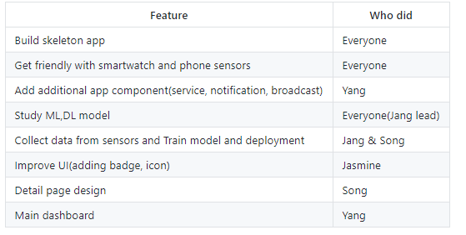
Project schedule - Done list before Mid

Slide 24
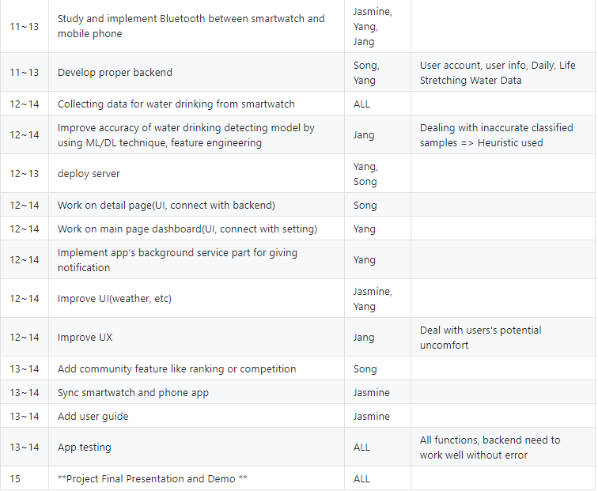
Project schedule - Timeline(mid ~ final)
Notes:
Change from previous plan : Separate two user case - 1. User with smartwatch, 2. User only with phone

Slide 25
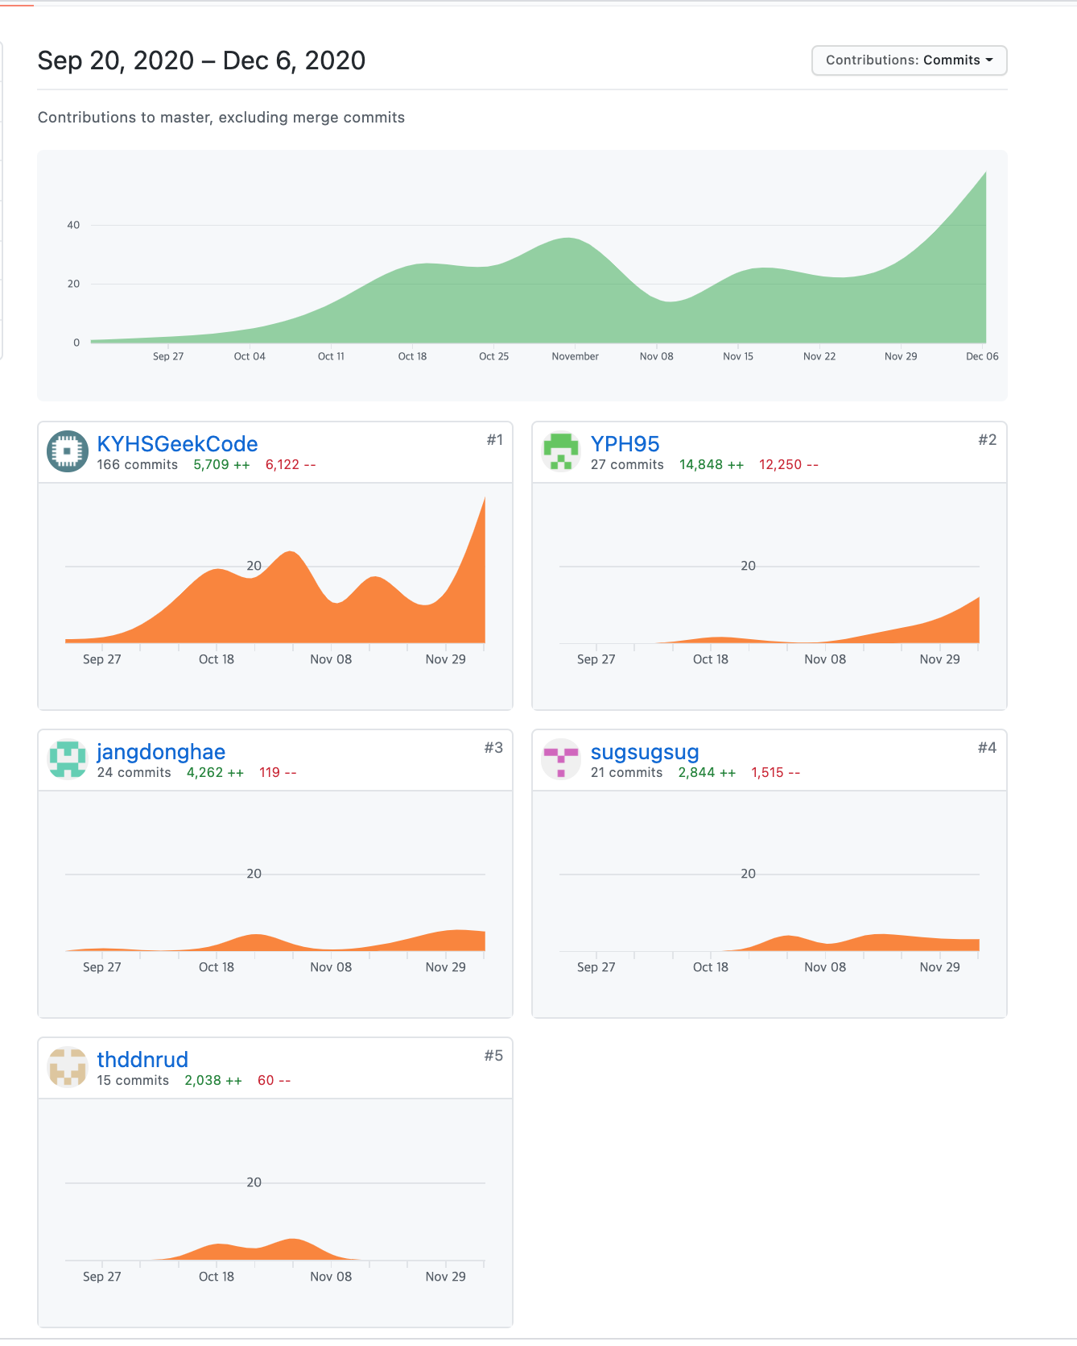
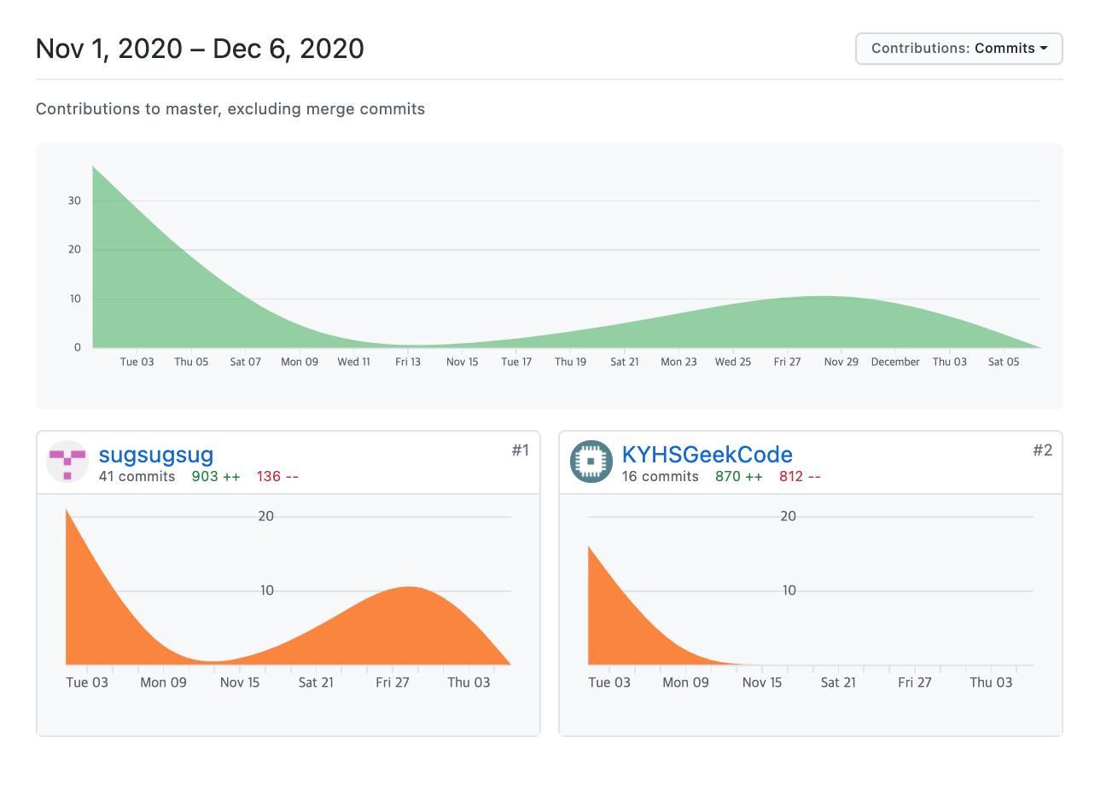
Git usage stats

Slide 26
Lessons learnt and reflections
We read a medical paper that diver’s HR becomes lower than 95% of its significance level, and tried HeartRate to detect water drinking motion more accurately but failed(sadly..) -> We learned paper and real situations can be quite different.
Watches memory and computation strength is not good enough -> need to wisely decide what parts of implementation needs to stay on watch and what should be on mobile.
Make our work smarter -> collecting user’s data and add predictions, user’s own model
And lastly, after A LOT of testing, we realized this couldn’t be more true: “No amount of testing can prove a software right, a single test can prove a software wrong.”

Slide 27
Thank you!
Notes:
Suggests: decide on our main app color (both theme and text) and apply to ppt.

